Slide 1
Arm Cortex Architect
Apr 14, 2024

Slide 2
1. Environment - Installation
Window 11 Pro 64-bit (10.0, Build 22631)
Arm GNU Toolchain Version 13.2.Rel1: arm_gnu_link
gdb-multiarch-14.1: gdb_link
qemu-20240411: qemu_link
Musca-board b1 bare-metal project: Musca_link
GnuMake: gnumake_link

Slide 3
2. GDB
Command | Description
run or r | Executes the program from start to end.
break or b | Sets a breakpoint on a particular line.
disable | Disables a breakpoint
enable | Enables a disabled breakpoint.
next or n | Executes the next line of code without diving into functions.
step | Goes to the next instruction, diving into the function.
list or l | Displays the code.
print or p | Displays the value of a variable.
quit or q | Exits out of GDB.
clear | Clears all breakpoints.
continue | Continues normal execution
info b, info r | Displays information of a breakpoint or a register

Slide 4
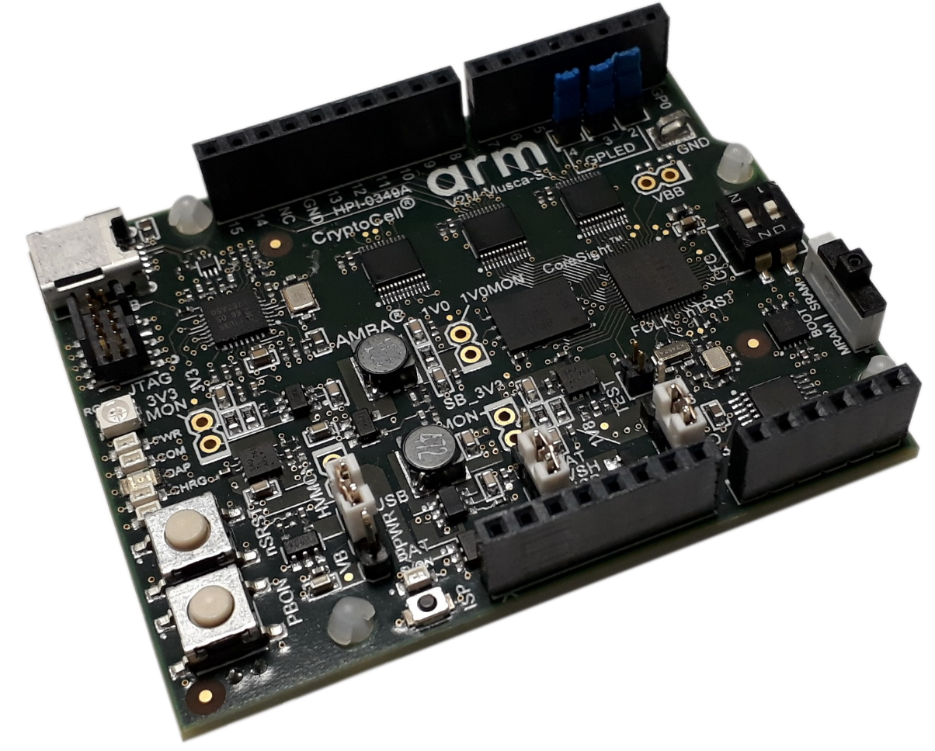
3. Musca B1 bare metal sample project

Slide 5
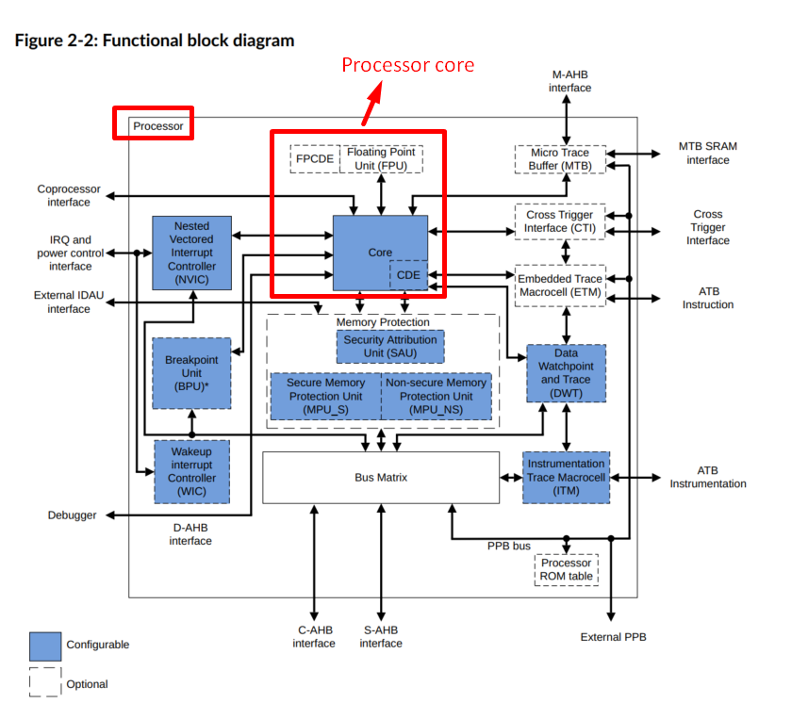
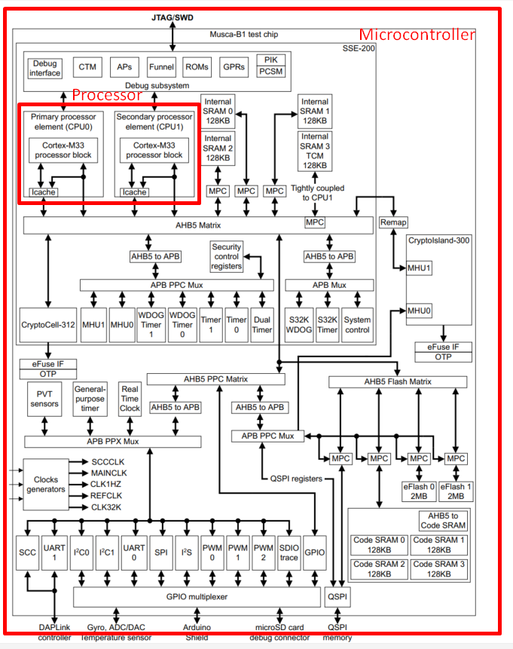
4. Processor core, processor and microcontroller

Slide 6
5. Operational modes of the Cortex-Mx processor

